Slide 1
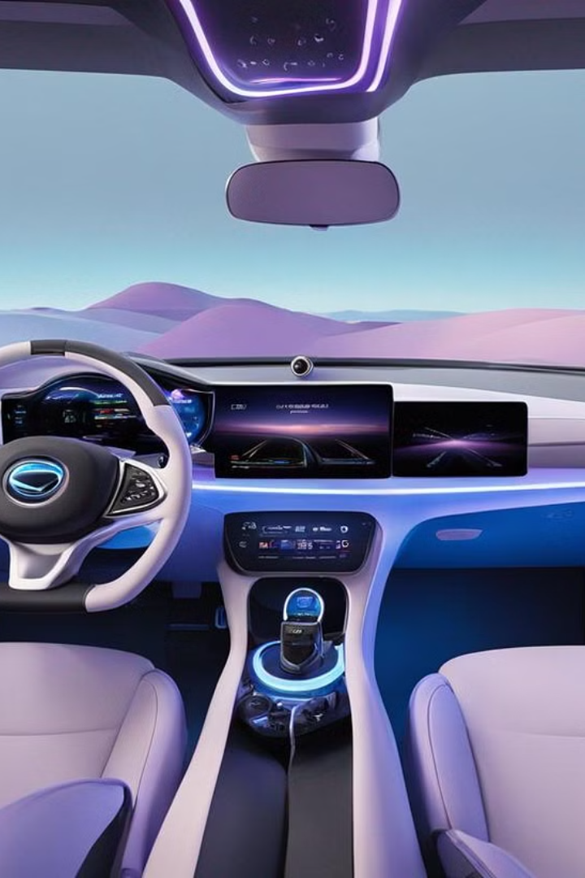


Human-Agent Collaboration in Smart Cockpit
Enhancing situational awareness for UX and safety.
by Yitong Hu

Slide 2

Background
1
Autonomous Evolution
Evolutionary journey toward L5 autonomy
2
Human Oversight
Necessity for human control
3
Human-Agent Collaboration
Enhancing driving experience and safty

Slide 3
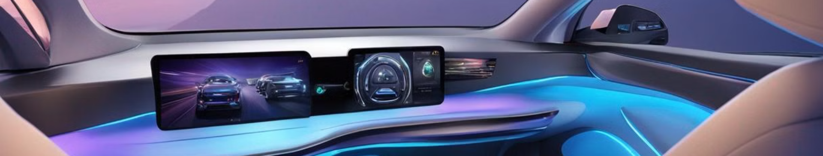
Finished Work
1
Requirement Analysis
2
Demo Design
3
System Arch. Design

Slide 4
Requirement Analysis
Improve UX
Improve Security
User perception enhancement
Complex conditions handling
Interactive cockpit functions
Low attention alerts
Autonomous preferences
Proactive threat alerts

Slide 5
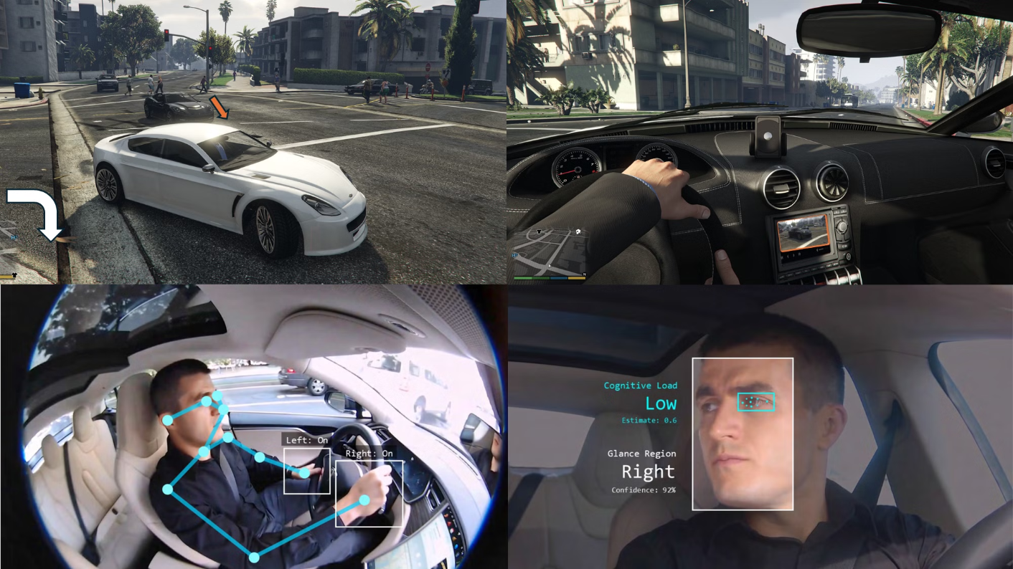
Demo

Slide 6
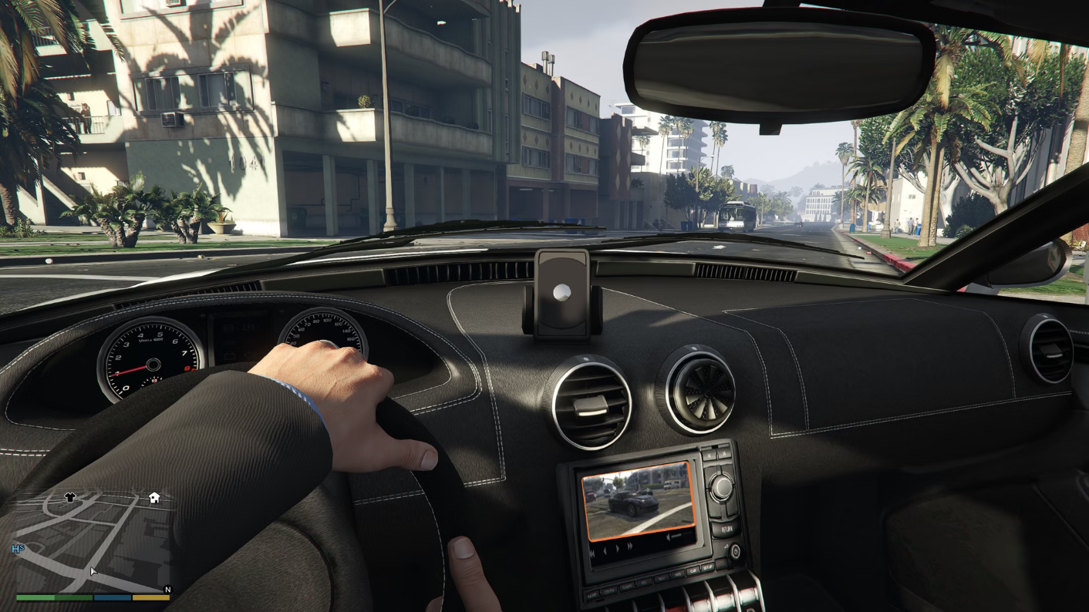
Demo

Slide 7

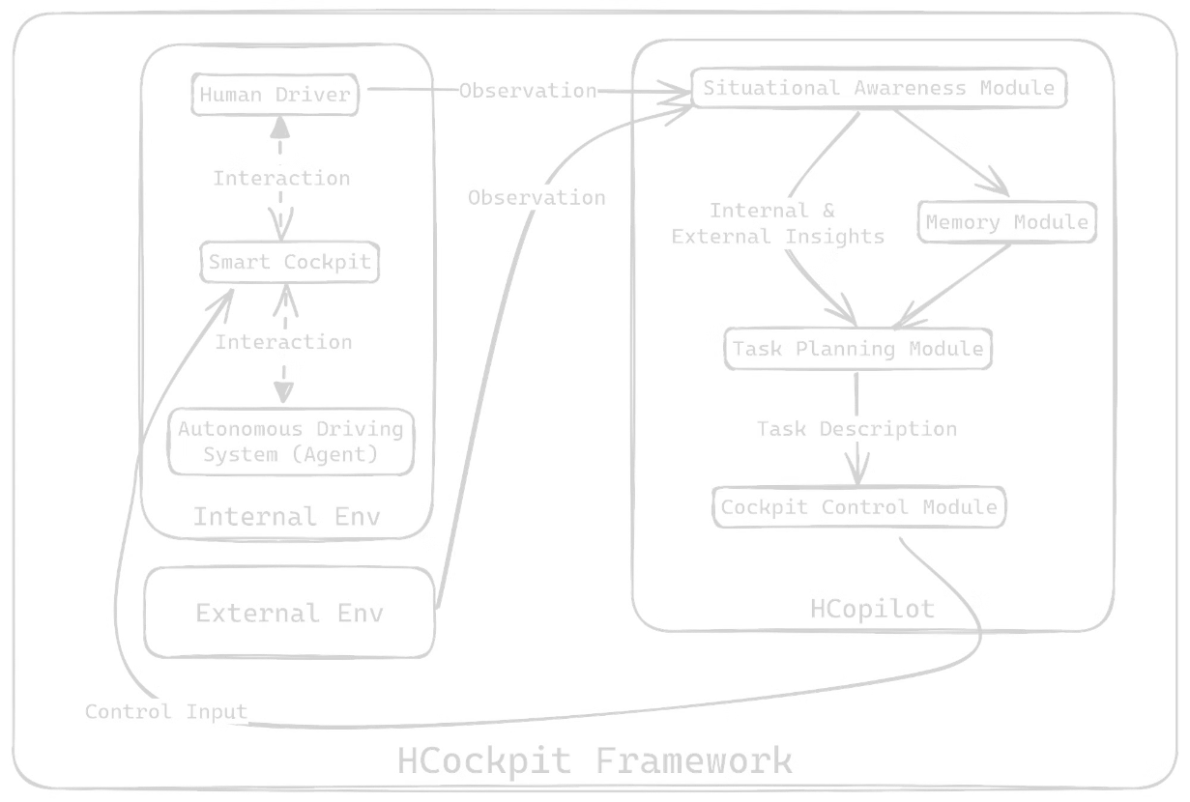
System Architecture Design

Slide 8
Next Step
Adapt and Integrate Machine Learning Models (undergoing)
Conduct Experiments
Develop a Demo
Test HCockpit in GTA V/CARLA
Demonstrate HCockpit’s capabilities on a variety of scenarios within the simulator
Adapt PaLI-X and PaLM-E
Adapt HCockpit to communicate with the simulator
Prompt-Tuning GPT-4 Turbo with Vision
Visualize HCockpit’s perception and decision-making process
Integrate OpenaAI CodeX/Google RT-2
Define key performance indicators (KPIs)

Slide 9

Thank You

